Slide 1
The Power of Gratitude for Personal and Professional Growth
Laura McMullin PhD
UCLA Teacher Education Program

Slide 2
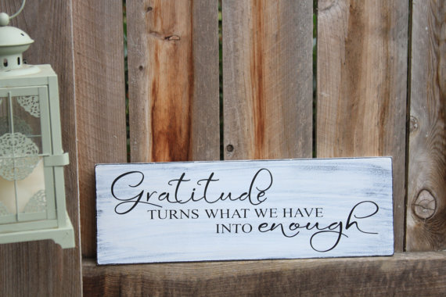

Slide 3
Gratitude Research
Dr. Robert Emmons
The worlds leading
scientific expert on gratitude
Psychology Professor - UC Davis
Thanks! How the
New Science of Gratitude
Can Make You Happier
Physical Health
Relationships
Psychological Wellbeing

Slide 4
Definition of Gratitude Two Components
1. It’s an affirmation of goodness.
“We affirm that there are good things in the world, gifts, and benefits we’ve received. This doesn’t mean life is perfect; it doesn’t ignore complaints, burdens, and hassles. But when we look at life as a whole, gratitude encourages us to identify some amount of goodness in our lives.”
~ Dr. Robert Emmons

Slide 5
Definition of Gratitude Two Components
2. Affirming where the goodness comes from.
“We recognize the sources of this goodness as being outside of ourselves. True gratitude involves a humble dependence on others: we acknowledge that other people—or even higher powers, if you’re of a spiritual mindset—gave us many gifts, big and small, to help us achieve in our lives”
~ Dr. Robert Edmmons

Slide 6
Gratitude Experiment
Journals to 300 people
A | B | C
Write Daily Lists

Slide 7
Findings:
Higher Level of Wellbeing
Slept Better
Exercised More

Slide 8
Key Findings: People who practice gratitude consistently
report a host of benefits
Physical
Stronger immune system
Less bothered by aches and pains
Social
More helpful, generous, and compassionate
Psychological
Lower blood pressure
Exercise more often and take better care of their health
Sleep longer and feel more refreshed upon waking
More forgiving
More outgoing
Feel less lonely and isolated
Higher levels of positive emotion
More alert, alive and aware
More joy and pleasure
More optimism and happiness

Slide 9
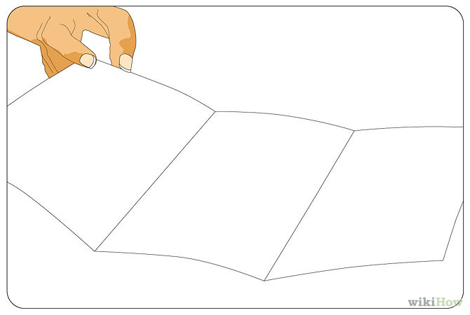
Let’s Practice!
People
Places
Things

Slide 10
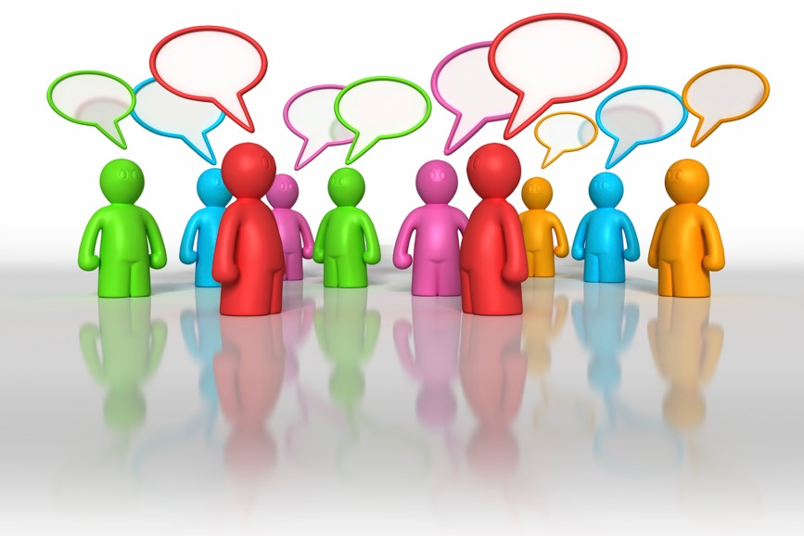

Slide 11
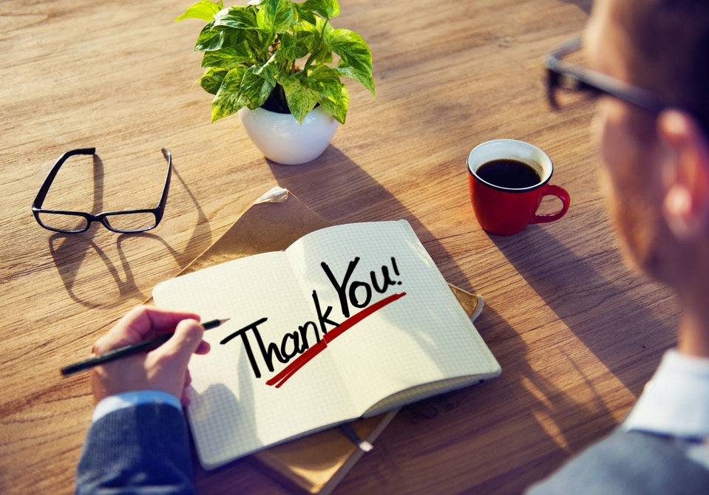

Slide 12
Gratitude at Work
Job Satisfaction
Sense of Community
Collaboration
Interdependence
Trust
Positive attitude
Drawing more meaning
Greater wellbeing and happiness
Social Support
Positive working environment
Performance
Retention
Engagement
Cohesion

Slide 13
Ways to Cultivate
Gratitude
Journal
List 3 Things
Morning +
Night time Routine
At Dinner
Gratitude Walk
Express Gratitude
At Stoplight or Traffic
Anytime
Anywhere
Any way

Slide 15
By the end of this weekend… Express Gratitude
Personal Life
Professional Life

Slide 16
Wonderful Resources
www.greatergood.berkeley.edu

Slide 18
Sincerely Grateful,
Laura McMullin PhD
mcmullin@gseis.ucla.edu

